Slide 1
Project Presentation
On
Improving Aspect-Based Sentiment Analysis with a Deep Context-Aware Model
By
Venkata Naga Janardhan Konasani
Pavan Chaitanya Galibu
Sushanth Arava
1

Slide 2
Introduction
Aspect-level sentiment analysis is crucial for understanding specific opinions within text, especially with the explosion of online content. Traditional methods often have difficulty in accurately identifying sentiment when the data is unclear, resulting in reduced accuracy and context awareness.
Long-Distance Dependencies:
"The restaurant, which was recommended by my best friend, has the best pasta."
Implicit Contextual Information:
"The battery life lasts forever, but the screen brightness is horrible."

Slide 3
Problem Definition
What is the challenge?
Understanding sentiments related to specific aspects of a text is complex, especially when context and word relationships are poorly modeled.
Why does it matter?
Businesses and researchers need better tools to extract precise insights from reviews, social media, and other text data.

Slide 4
Proposed Method
DCASAM + HAN
Deep Context-Aware Sentiment Analysis Model + Hierarchical Attention Networks
DCASAM Enhances BERT's ability to understand context through advanced components like DBiLSTM and DGCN.
Combines BERT (for word embeddings) with:
DBiLSTM (Dual Bidirectional LSTM): To capture long-term dependencies in both directions.
DGCN (Dynamic Graph Convolutional Networks): To model relationships between words effectively.
HAN Utilizes multi-level attention to focus on important aspects of the text for accurate sentiment analysis

Slide 5
Description of the Testbed
Dataset:
We are using the IMDB dataset, a collection of 50,000 movie reviews labeled for binary sentiment classification (positive or negative)
Task:
Performing aspect-based sentiment analysis (ABSA) on reviews of IMDB Dataset.
Model Setup:
Comparing the performance of the base model (DCASAM) with the enhanced model (DCASAM + HAN).
Metrics for Evaluation:
Accuracy, Precision, Recall, and F1-Score to measure how well the models classify sentiment for specific aspects.

Slide 6
Questions the Experiments Aim to Answer
Does HAN improve the accuracy of aspect-specific sentiment analysis in DCASAM?
Can DCASAM + HAN handle reviews with multiple aspects better than DCASAM alone?
How does the model perform compared to existing state-of-the-art models?

Slide 7
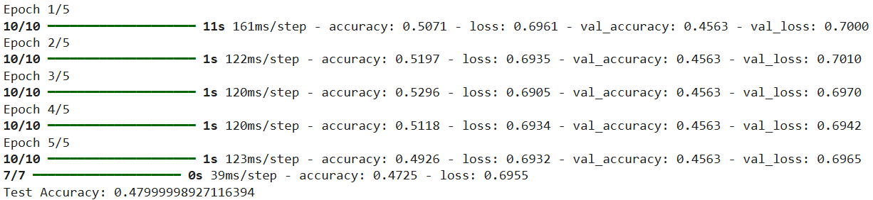
Details of the Experiments
Experiment-1
What we did: Trained and tested an LSTM model using the Laptop dataset.
Observation: The accuracy was relatively low compared to the IMDB dataset, partly because the Restaurant14 dataset is smaller in size, limiting the model's learning capability. Additionally, the dataset had more domain-specific challenges, making it harder for the LSTM to capture complex patterns and sentiments effectively.

Slide 8
Details of the Experiments
Experiment-2
What we did: Applied the DCASAM model on the IMDB dataset to evaluate its performance.
Observation: The accuracy was lower than the LSTM model tested on the IMDB dataset, suggesting that DCASAM alone struggled with aspect-specific sentiment classification on this dataset.

Slide 9
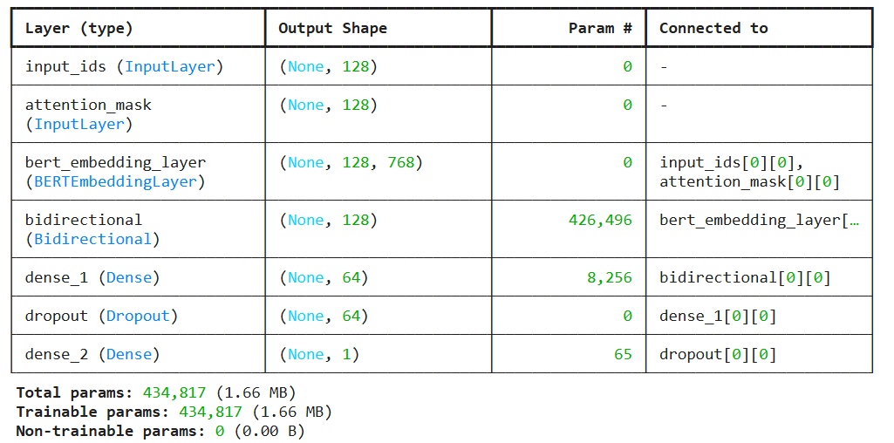
Details of the Experiments
Experiment-2

Slide 10
Details of the Experiments
Experiment-3
What we did: Enhanced the model by integrating HAN (DCASAM + HAN) and tested it on the IMDB dataset.
Observation: The accuracy improved over the DCASAM model, showing that adding HAN helped the model focus on important words and sentences for better aspect-level sentiment classification.

Slide 11
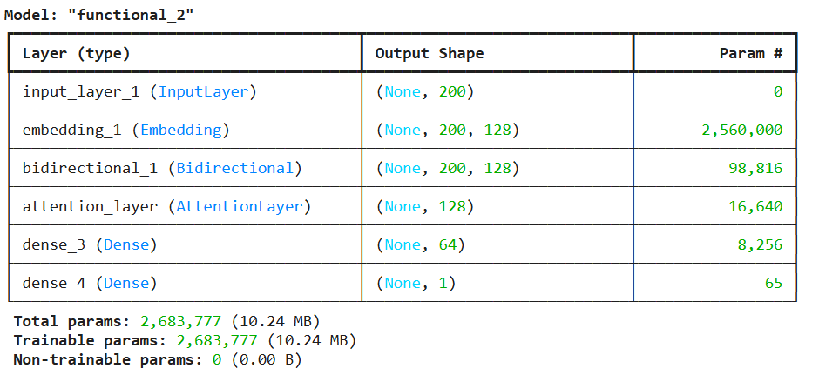
Details of the Experiments
Experiment-3

Slide 12
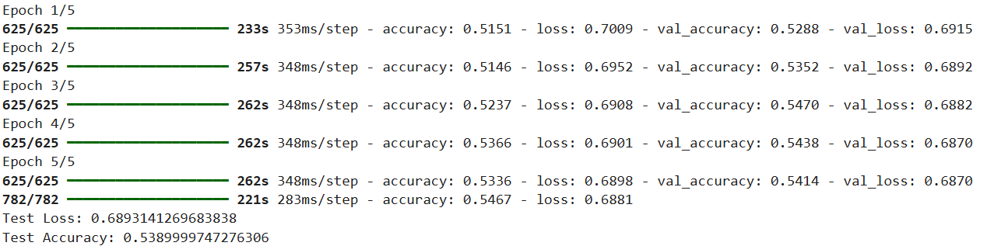
Details of the Experiments
Observations / Results
DCASAM (Without HAN): Accuracy – around 54%
Performs well on simpler reviews but struggles with reviews having multiple aspects.
Fails to accurately prioritize sentiment words related to specific aspects.

Slide 13
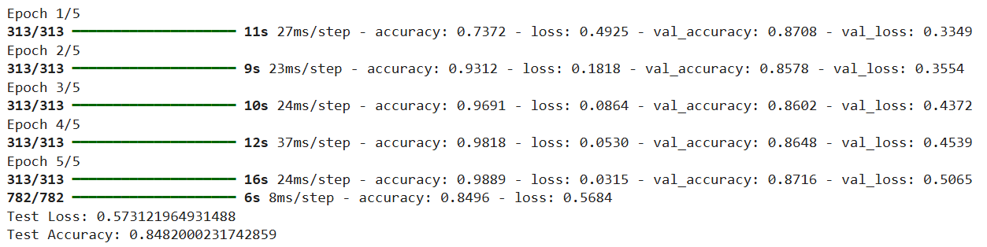
Details of the Experiments
Observations / Results
DCASAM (With HAN): Accuracy – 85% approx.
Improves accuracy by focusing on important words and sentences for each aspect.
Handles conflicting sentiments more effectively.
Outperforms state-of-the-art models in terms of aspect-specific sentiment classification accuracy

Slide 14
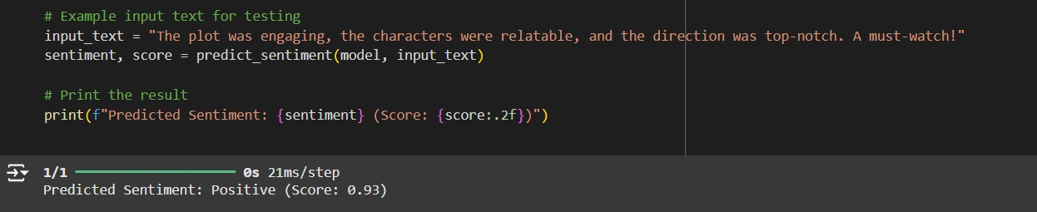
Details of the Experiments
Observations / Results
DCASAM (With HAN): Accuracy – 85% approx.

Slide 15
Conclusion
The LSTM model performed best on the IMDB dataset but struggled with the smaller Restaurant14 dataset due to its limited size and complexity.
DCASAM improved performance over LSTM but still faced challenges with multi-aspect reviews.
Adding HAN improves DCASAM by making the model explicitly aware of hierarchical structures in the text, leading to better aspect-specific sentiment understanding

Slide 16
Future Work
Move beyond the traditional positive, negative, and neutral polarities to include specific emotions like joy, anger, fear, sadness, disgust, surprise, trust, and anticipation.
Adapt the HAN-enhanced DCASAM for multilingual datasets to address sentiment analysis across languages.
Develop a real-time sentiment analysis API using the enhanced model to provide instant feedback on text inputs, enabling seamless integration with applications like customer feedback systems, social media monitoring, and content moderation.

Slide 17
Thank you!

